Slide 1


LendaBank: Built for Trust. Ready for Scale

Slide 2



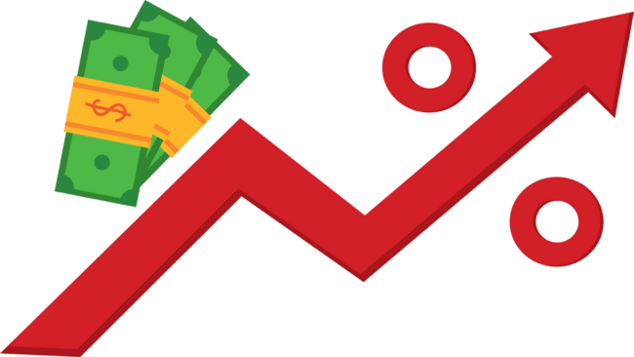
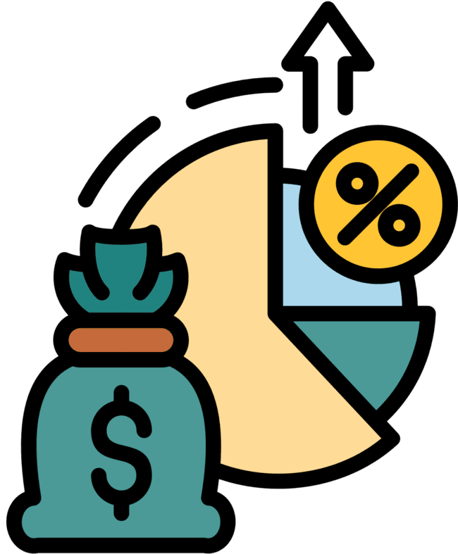









Executive Summary
A Strategy for Sustainable Growth
Over 500,000
customers
₦12 billion
loan book
₦4.5 billion
in revenue
12% net
profit margin
S
Situation
New CBN KYC regulations -₦150 million
Defaults have doubled from 4.5% to 9%
Investor pressure to scale rural reach and fast-track ₦500M blockchain rollout
C
Complication
Q
Balancing ethical growth, speed, trust, and regulation. What’s the path forward?
Question
Phased blockchain investment
Rural Expansion via Partnerships
A
Comply & Compete
Tiered KYC process
Transparent, Inclusive Scoring
Ethical
Collections
Answer

Slide 3




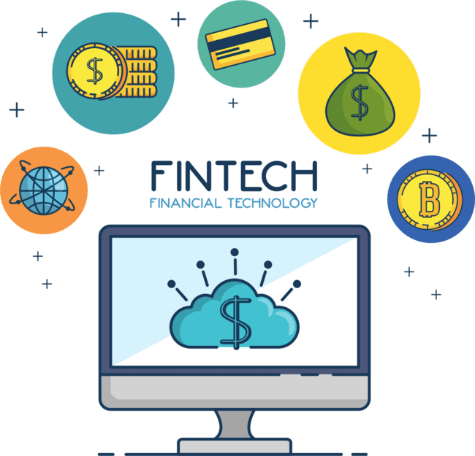





Fintech in Nigeria: Growth, Regulation & Competitive Pressures
Industry Landscape Snapshot
Strategic Pressures (Porter Highlights)
Market Size & Growth
Competitive Rivalry
Growing at 25.6% CAGR from 2024–2032
Carbon, FairMoney, PalmPay
Mobile-First Behavior
Buyer Power
64% of financially active Nigerians
Users demand flexibility, ethics, and full transparency
Funding Surge
Threat of Substitutes
$1.3B in African fintech funding in 2022
BNPL, micro-saving apps, informal lending groups
CBN Crackdowns
Regulatory Threat
Delisted several loan apps for policy violations
New KYC, data laws, AI scrutiny
Nigeria-Fintech
CBN Crackdown
Fintech CAGR

Slide 4
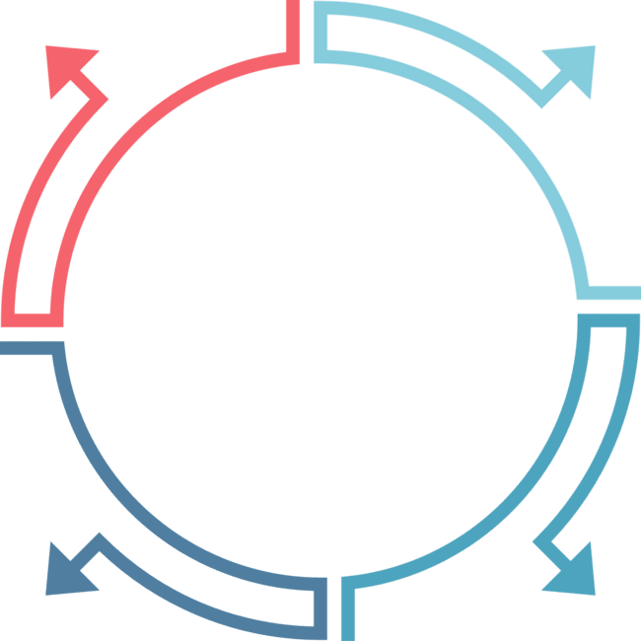


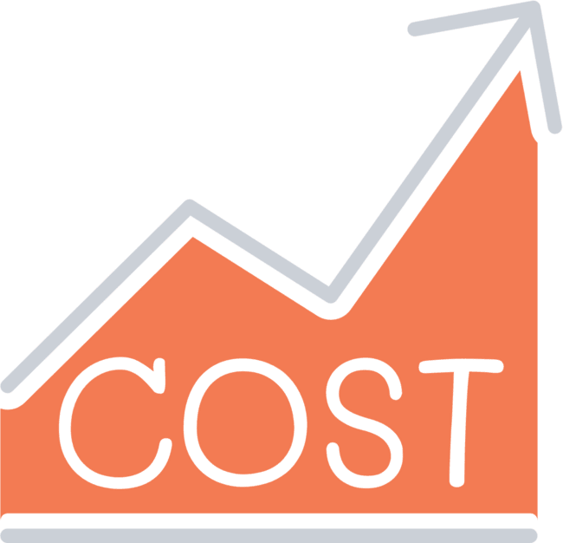



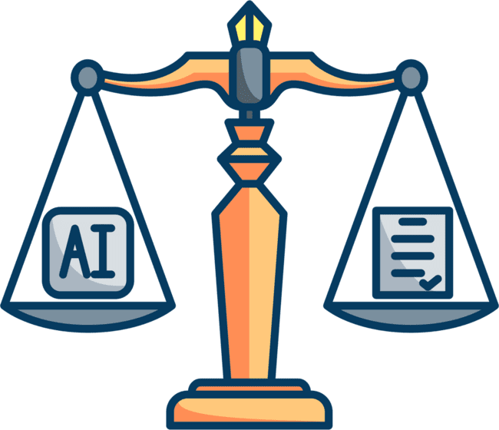


Regulatory Pressure & Reputational Risk
Regulatory Pressures
Reputational Risk
₦150 million in KYC compliance costs
Default rate increased from 4.5% to 9%
New Tiered KYC rules increase documentation and onboarding time
Aggressive debt collection (public shaming)
Ethical AI Scrutiny
Lack of transparency in loan approval/rejection process
₦500 million blockchain upgrade - high upfront investment with unclear ROI

Slide 5





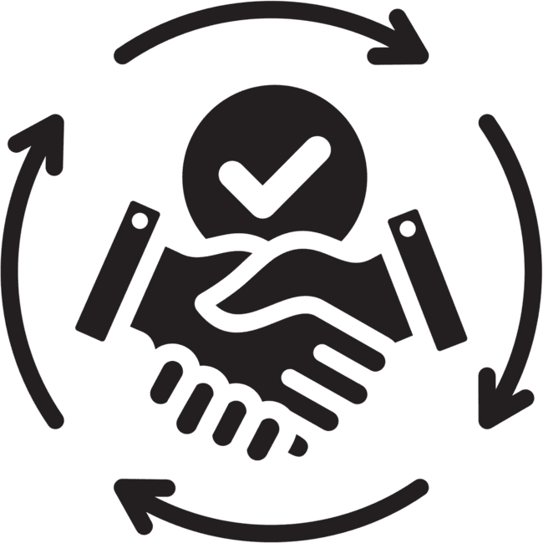



Our Five-Pillar Strategy for Sustainable Growth
A phased, data-driven plan balancing growth, trust, and regulation
Tiered KYC & Compliance
Ethical Collections
Phased Blockchain Investment
Rural Footprint with Partnerships
Explainable AI & Inclusive Scoring

Slide 6

Comply & Compete: Tiered KYC for Speed & Smart Compliance
Tier 3 (High risk)
Above ₦1 million, full documentary and on‑site checks.
Tier 2 (Medium risk)
Requires BVN/NIN and proof of address for loans ₦100K–₦1M.
Tier 1 (Low risk)
Minimal ID (NIN, phone number) for loans up to ₦100K.

Slide 7




Ethical Collections: From Pressure to Partnership
Collections should not compromise dignity—ethical recovery builds trust, retention, and reputation
End aggressive tactics
Adopt soft-touch collections
Replace with rights-based communication standards
Use SMS, email, and in-app nudges
Introduce loan restructuring options
Train recovery agents in empathy & ethics
Offer flexible repayment plans for high-intent defaulters
Align with NDIC and FCCPC responsible lending codes

Slide 8
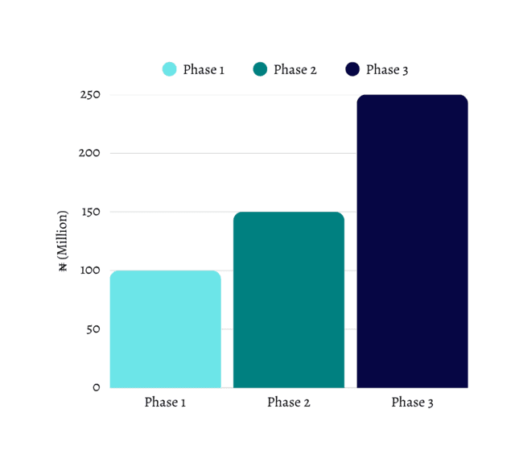
Phased Blockchain: Secure Data, Smarter Investment
Phase the ₦500M investment over 3 stages tied to performance milestones
Start with smart contract pilots for repayment logging and loan disbursements
Boost traceability & reduce fraud across customer data and credit histories
Aligns with regulatory push for data security without compromising cashflow

Slide 9











Rural Expansion: Agent Models, Not Branches
Leverage existing rural networks—no branches, no heavy CAPEX.
LendaBank
Local Market Hubs
Agent Networks
Co-operatives
mobile wallets + digital literacy training
Telcos

Slide 10
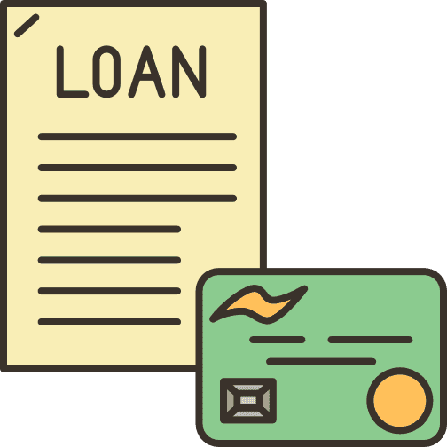


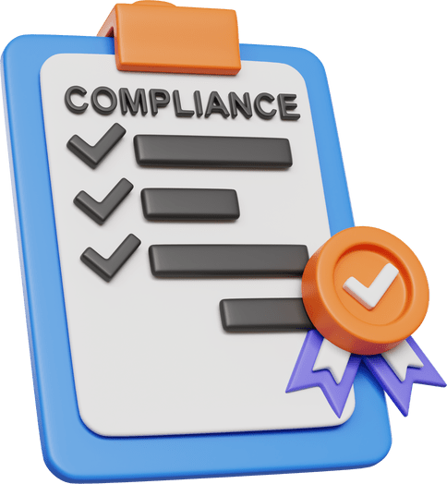
Explainable AI: Building Trust Through Transparency
Black-box AI undermines trust. We propose AI that explains itself—fair, fast, and regulator-ready.
Credit Clarity Portal
Reduce bias & increase fairness
Shows users why a loan was approved or denied
Regular fairness audits across gender, location, and income
Integrate explainability tools
Strengthens regulatory compliance
Highlights key decision factors in scoring

Slide 11


Fairness Audits in the AI Pipeline
Customer Data
Data Preprocessing
AI Credit Scoring Model
Flags disparities
Fairness Audit Layer
Detects bias
Credit Clarity Portal
Monitoring

Slide 12
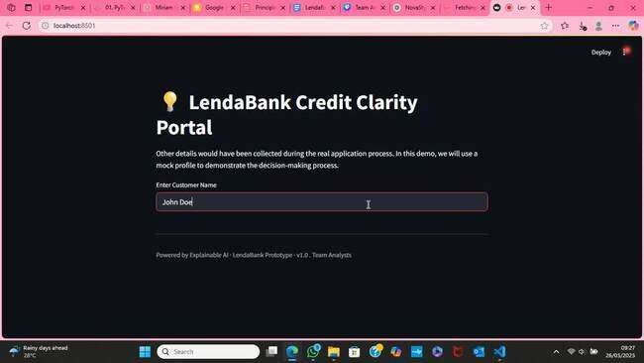
Credit Clarity Portal – Prototype Demo

Slide 13






15-Month Investment Timeline with ROI-Based Financial Projections
Q3 2025
Q4 2025–
Q 1 2026
Phases
Q2–Q3 2026
Timeline
3 months
6 months
6 months
Investment
₦200 million total
₦250 million phased
₦300 million finish
Tiered KYC launch;
XAI portal MVP; ethics board
Blockchain Phases 1–2;
rural agent onboarding
Full blockchain integration;
scale collections
Deliverables
Projected ROI
10% drop in time-to-approve; 5% fewer defaults
15% KYC fraud
reduction; +20k rural customers
25% improved NPL ratio; 12% revenue uplift

Slide 14
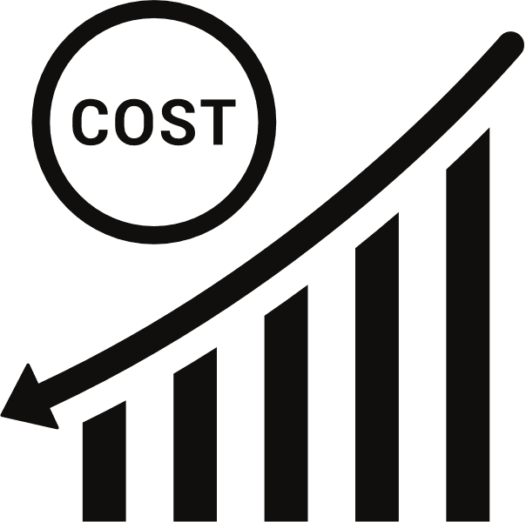


Cumulative impact by Q3 2026
30% lower default costs
driving +₦500 million
in incremental
loans
saving ₦200 million
annually
adding ₦3 billion in
new loans at
15% margin
Expanded
rural book
20% faster loan
approvals

Slide 15






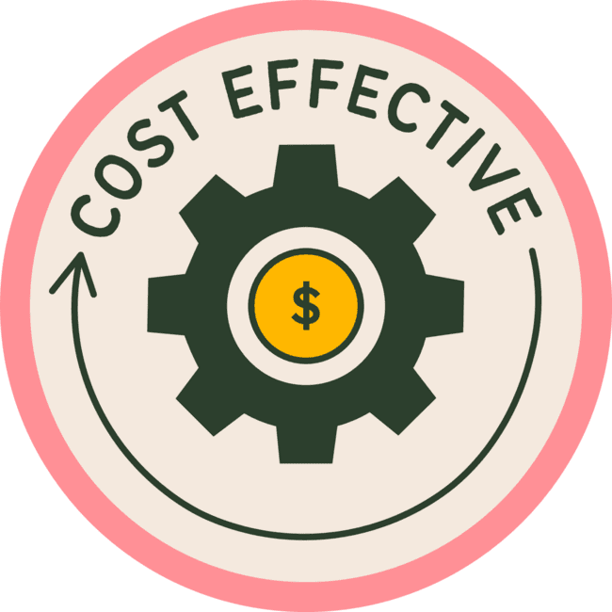
Risks
Mitigations
Regulatory Scrutiny Over AI Bias & Transparency
Deploy explainable AI tools
Partner only with vetted MFIs and
cooperatives
Rural Agent Risk
Release funding only after milestone KPIs
are met for each stage
Cost Overruns from Tech Infrastructure Rollout

Slide 16

Conclusion: Scalable, Responsible Growth for LendaBank
We’ve shown how LendaBank can scale with confidence
not by spending more, but by spending smarter.

Slide 17

Sources & Citations – Financial Impact & Blockchain Roadmap
McKinsey & Co. – “Blockchain for Financial Services” (2022)
Provenance.io – “Blockchain’s Role in KYC Integrity”
World Bank – LAPO Agent Banking Case Study in Nigeria (2021)
Central Bank of Nigeria – Blockchain Adoption Framework (2021)
nCino – Explainable AI & Credit Approvals
AFI – Tiered KYC for Financial Inclusion (2019)
McKinsey – Ethical Collections in Digital Lending (2021)

Slide 18


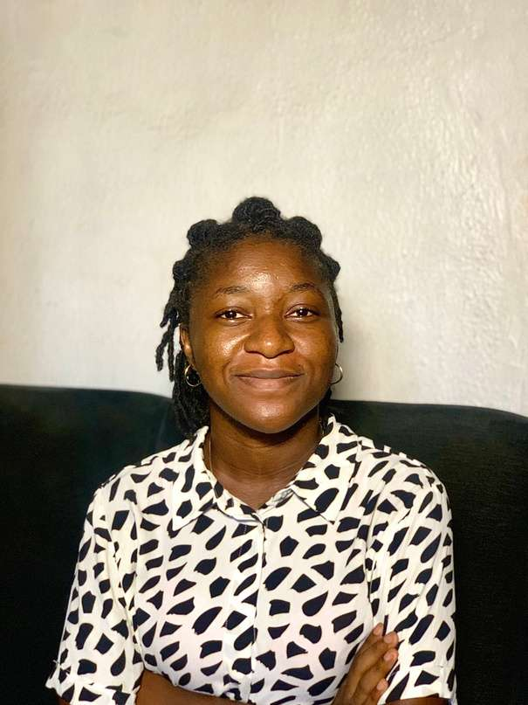

TrustEdge Consulting
Abideen A.
Miriam O.
Kemi M.
Kolade A.
Operations & Risk
Consultant
Finance & Partnerships
Consultant
Lead Strategy Consultant
Technology Consultant
Transparent. Strategic. Scalable.

